Slide 1
CompTIA A+ Guide to IT Technical Support
10th Edition

Slide 2
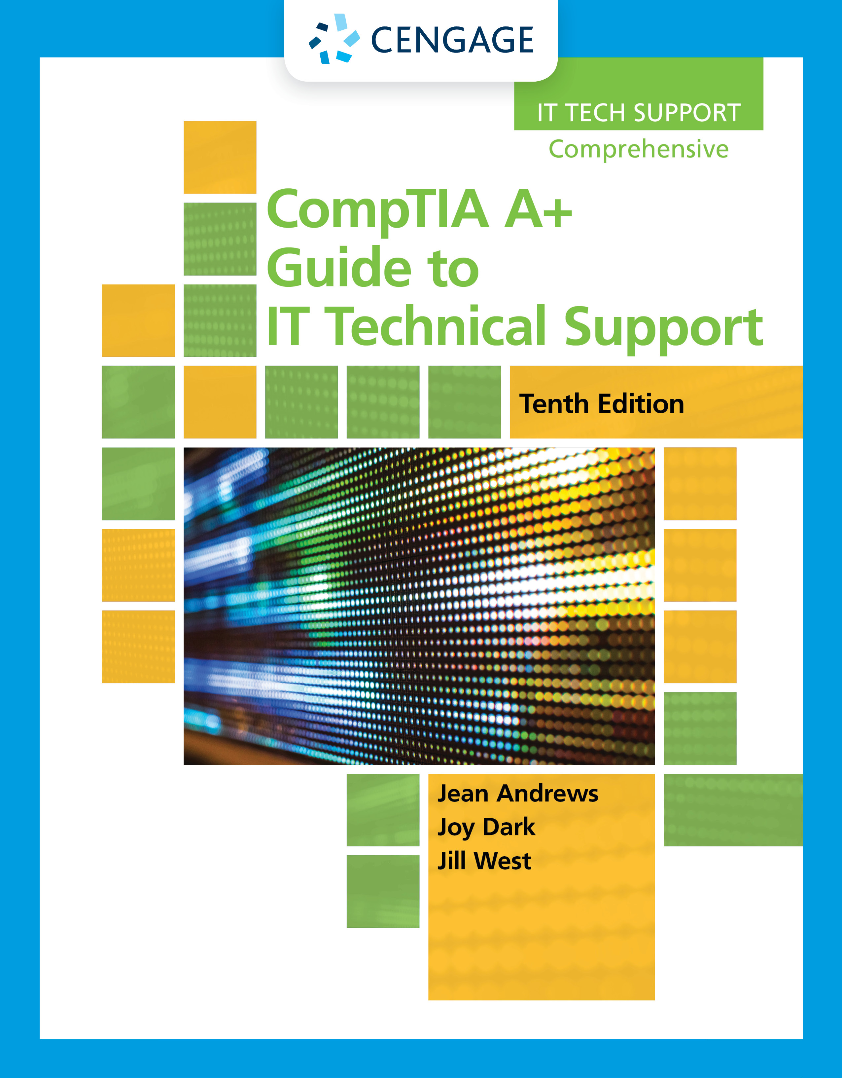
Troubleshooting Windows After Startup
Chapter 14

Slide 3
Objectives
Explain the concepts and describe Windows tools used to solve problems with Windows, applications, and hardware
Apply recommended best practices to troubleshoot Windows-related problems
Troubleshoot problems with slow startup and slow performance
Troubleshoot application errors and crashes
Manually remove software when an application fails to uninstall
Troubleshoot hardware problems in Windows

Slide 4
Concepts and Windows Tools for Solving Problems With Windows, Applications, and Hardware
This part of the chapter covers:
How Windows works and how it is structured
Windows tools that are useful when solving a problem with Windows, applications, Windows users, networks, and hardware

Slide 5
What are the Shell and the Kernel? (1 of 2)
The Windows Shell:
The portion of an OS that relates to the user and to applications
Provides tools such as File Explorer and the Windows desktop
Made up of subsystems that operate in user mode
Means these subsystems have only limited access to system information
The Windows Kernel:
Responsible for interacting with hardware
Known as the “core” of the OS
Has two main components:
HAL (hardware abstraction layer) – layer closest to hardware
Executive services interface – operate between the user mode subsystems and the HAL

Slide 6
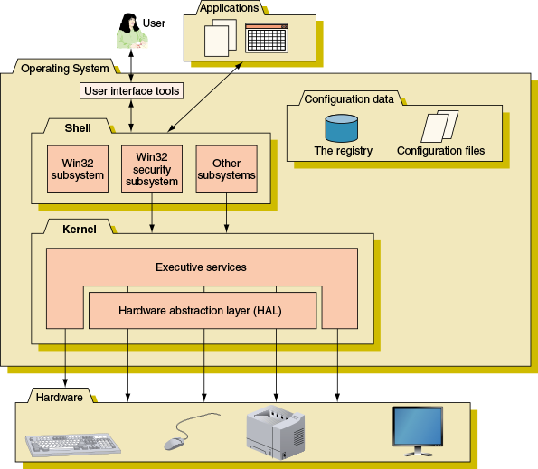
What are the Shell and the Kernel? (2 of 2)
Figure 14-1 Inside an operating system, different components perform various functions

Slide 7
Directory Structures (1 of 2)
User Profile Namespace
When a user first signs in to Windows, a user profile is created and consists of two general items:
A user folder together with its subfolders
NTUSER.DAT – a hidden file stored in the C:\Users\username folder that contains user settings
Program Files
Program files are stored in C:\Program Files
In 64-bit versions of Windows, 64-bit programs are stored here and 32-bit programs are stored in C:\Program Files (x86)

Slide 8
Directory Structures (2 of 2)
Folders for Windows Data
Windows uses a database called the registry to store hardware and software configuration information, user preferences, and application settings
Windows also keeps some data in text files called initialization files
Important folder locations used for the registry and other Windows data:
Registry location: C:\Windows\System32\config folder
Backup of the registry: C:\Windows\System32\config\RegBack
Fonts: C:\Windows\Fonts
Temporary files: C:\Windows\Temp
Offline files: C:\Windows\CSC

Slide 9
How Windows Manages Applications (1 of 2)
A process is a program that is running under the authority of the shell, together with the system resources assigned to it
When a process makes a request for resources to the Win32 subsystem the request is known as a thread
A thread is a single task, such as printing a file that the process requests from the kernel
Sometimes a process is called an instance
A process with more than one thread is called multithreading

Slide 10
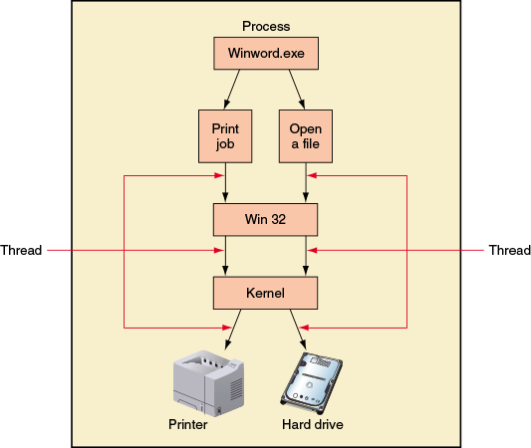
How Windows Manages Applications (2 of 2)
Figure 14-2 A process with more than one thread is called multithreading

Slide 11
Survey of Windows Tools and Techniques
Windows provides many useful tools and techniques for managing and troubleshooting Windows, applications, users, hardware, and networks
See Table 14-1 for a list of many of these tools

Slide 12
Best Practices To Troubleshoot Windows-Related Problems
This section gives you a general strategy to follow when solving any problems with Windows, an applications, or hardware

Slide 13
Step 1: Interview the User and Back Up Data
When the user is available, start troubleshooting:
Interview the user and back up data
Ask the user to reproduce the problem while you watch
Try a reboot

Slide 14
Step 2: Error Messages, The Web, Coworkers, and Logs Might Help (1 of 3)
Use Event Viewer and Reliability Monitor to Look For Clues
Event Viewer logs might give clues about hardware or network failure, OS error messages, a device or service that has failed to start, or general protection faults
Use Reliability Monitor to look for errors with applications or with key hardware components such as the hard drive
Logs that are most useful:
Administrative Events log
Application log
Security log
Setup log
System log
Forwarded Events log

Slide 15
Step 2: Error Messages, The Web, Coworkers, and Logs Might Help (2 of 3)
Try the Troubleshooting Applet and Device Manager
Drill down into a category in this window to see what Windows offers to solve a problem
When the problem is hardware related, check Device Manager
Sometimes uninstalling a device and then reinstalling it solves the problem
Find and Ask for Help
Search for the error message or description of the problem on the web
Add site:microsoft.com to the end of the search text to target your search to Microsoft websites
Look for forums where others have posted the same problem with the same app or device

Slide 16
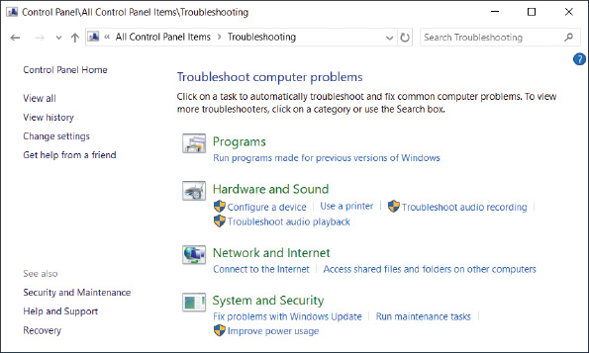
Step 2: Error Messages, The Web, Coworkers, and Logs Might Help (3 of 3)
Figure 14-7 Use the Troubleshooting applet early in the troubleshooting process to solve simple Windows, application, hardware, network, and security problems

Slide 17
Step 3: Consider That the Data or the Application Might Be Corrupted
For general problems with applications, consider and do these things:
Consider data corruption
Check application settings and logs for errors
Repair the application
Uninstall and reinstall the application

Slide 18
Step 4: Consider Outside Interference (1 of 5)
Malware is at Work
Scan the system for malware using up-to-date anti-malware software
Faulty Memory
Start the Windows Memory Diagnostics tool by using one of the following methods:
Use the mdsched.exe command
Boot from Windows setup media
Corrupted Hard Drive
Use the chkdsk c: /r command to check the hard drive
Searches for bad sectors on a volume and recovers the data from them if possible
Also check Event Viewer for warnings or errors regarding the hard drive

Slide 19
Step 4: Consider Outside Interference (2 of 5)
Low on System Resources
Use Task Manager to verify that a process is not using excessive system resources
Ways to access Task Manager:
Press Ctrl+Alt+Del
Press Ctrl+Shift+Esc
For Windows 10/8, press Win+X and click Task Manager in the Quick Launch menu
For Windows 7, click Start, enter taskmgr.exe in the search box and press Enter

Slide 20
Step 4: Consider Outside Interference (3 of 5)
Low on System Resources (continued)
Tabs in Task Manager include:
Processes tab and Details tab
Performance tab
App history tab
Startup tab
Users tab
Service tab

Slide 21
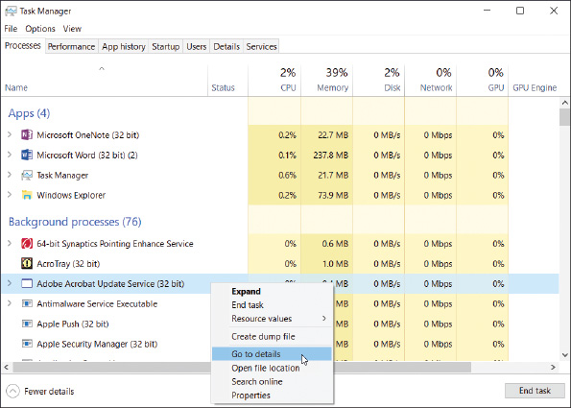
Step 4: Consider Outside Interference (4 of 5)
Figure 14-13 The Windows 10 Task Manager window with the Processes tab selected

Slide 22
Step 4: Consider Outside Interference (5 of 5)
Incompatible Applications or Third-Party Services
To eliminate conflicts or compatibility issues with other software, run the application causing problems after a clean boot
A clean boot eliminates third-party software from starting during the boot and is done using System Configuration and Task Manager
If a clean boot allows the application to run without errors:
Zero in on the third-party software until you discover the one in conflict

Slide 23
Step 5: Consider That Windows Might Be the Problem (1 of 4)
An application or device might be giving problems because Windows system files are missing or corrupted
Update Windows
Make sure all critical and important Windows updates are installed
Use System File Checker
Use System File Check (SFC) to verify and replace system files
Open an elevated command prompt window and enter the sfc /scannow command
Use DISM to Repair System Files
You can use DISM commands to repair an existing Windows installation
Try SFC first, if that doesn’t work, turn to DISM

Slide 24
Step 5: Consider That Windows Might Be the Problem (2 of 4)
Use DISM to Repair System Files (continued)
Some useful DISM commands:
dism /online /cleanup-image /scanhealth
dism /online /cleanup-image /checkhealth
dism /online /cleanup-image /restorehealth
dism /online /cleanup-image /restorehealth /source: install.wim /limitaccess
Boot Windows in Safe Mode
Safe Mode loads Windows with a minimum configuration and can create a stable environment when Windows gets corrupted

Slide 25
Step 5: Consider That Windows Might Be the Problem (3 of 4)
Use System Restore
Use System Restore if you know the approximate date the error started
Points to keep in mind:
System Restore might make many changes to a system
System Restore won’t help you if you don’t have restore points to use
Restore points replace certain keys in the registry but cannot completely rebuild a totally corrupted registry
The restore process cannot remove a virus or worm infection
System Restore might create a new problem
Restore points are kept in a hidden folder on the hard drive
Viruses and other malware sometimes hide in restore points
If Windows will not start, you can launch System Restore using startup recovery tools

Slide 26
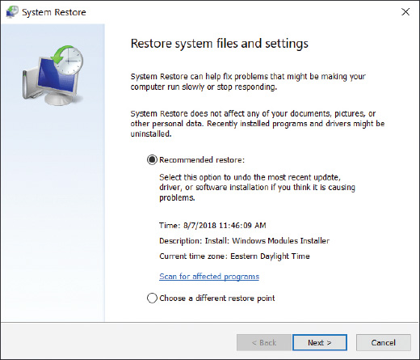
Step 5: Consider That Windows Might Be the Problem (4 of 4)
Figure 14-28 Select a restore point

Slide 27
Slow Startup and Slow Performance
If Windows starts slowly or performs slowly:
Use the following steps to clean up the startup process and improve performance

Slide 28
Step 1: Observe Startup
To get a benchmark of how fast Windows starts, do the following:
Use a stopwatch to time a normal startup from the moment you press the power button until the wait icon on the Windows desktop disappears
Follow the steps given earlier in the chapter to set up a clean boot and time the boot again, this time using a clean boot
If there is no difference, you can assume startup processes are not the source of the problem
If the difference is significant, follow the steps in this part of the chapter to reduce Windows startup to essentials

Slide 29
Step 2: Back Up User Data
If valuable data is not backed up:
Back it up before you apply any of the fixes in this chapter

Slide 30
Step 3: Perform Routine Maintenance
Perform some of the routine maintenance tasks that you learned in Chapter 13:
Verify critical Windows settings
Uninstall software you no longer need and optimize the hard drive

Slide 31
Step 4: Investigate and Eliminate Startup Programs
Tools to help search for unnecessary startup programs are System Configuration (msconfig.exe), startup folders, and Task Manager
Follow these steps to investigate startup:
Open the Startup tab in Windows 10/8 Task Manager or the Startup tab in Windows 7 System Configuration
In the list of startup items, look for a specific startup program you don’t want
If you want to find out whether disabling a startup entry gives problems or improves performance, temporarily disable it using Windows 10/8 Task Manager or Windows 7 System Configuration
As you research startup processes, Task Manager can tell you what processes are currently running
Open Task Manager and select the Processes tab

Slide 32
Step 5: Check for Unwanted Scheduled Tasks
When applications install:
They often schedule tasks to check for and download program updates
Malware sometimes hides as a scheduled task
Best way to uninstall a scheduled task is to uninstall the software that is responsible for the task
Open the Task Scheduler window:
Search through tasks to find those you think are unnecessary or causing trouble
Decide if you want to uninstall the software or disable the task

Slide 33
Step 6: Check for Low System Resources
Follow directions in the “Low on System Resources” section earlier in this chapter to check a hardware component that might be a bottleneck
You may also improve performance by moving the virtual memory file (pagefile.sys)
Windows uses this file in the same way it uses memory to enhance the amount of RAM in a system
Try moving it to another volume on the same hard drive or to a different hard drive

Slide 34
Application Errors and Crashes
In this part of the chapter, you learn to deal with specific application errors and crashes

Slide 35
Application Hangs
If an application locks up, use Task Manager to end it
If Task Manager can’t end a process, use the tasklist and taskkill commands
Tasklist command returns the process identifier (PID)
Taskkill command uses the process ID to kill the process
How to use the commands, using Notepad as our sample application:
Start Notepad
Use the tasklist | more command to see a list of running processes and note the PID of the Notepad process (7132)
Enter the command taskkill /f /pid:7132 to forcefully kill the process

Slide 36
Slow-Performing Application (1 of 2)
Each application running on your computer is assigned a priority level
Determines its position in the queue for CPU resources
You can use Task Manager to change the priority level for an application that is already open
1. In Task Manager, click the Processes tab, right-click the application, and click Go to details
2. On the Details tab, right-click the selected program and point to Set priority
Set the new priority to Above normal or High
Changes you make to an application’s priority level affect only the current session

Slide 37
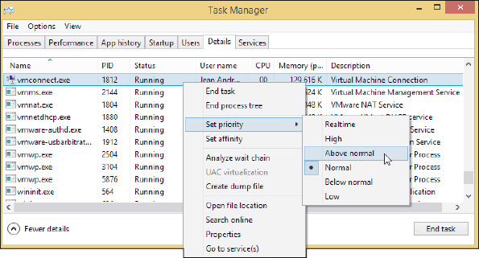
Slow-Performing Application (2 of 2)
Figure 14-33 Change the priority level of a running application

Slide 38
Service Fails to Start
An error results when an application expects a background service to be running but it failed to start
To manage services, enter the services.msc command to open the Services console
If the Extended tab at the bottom of the window is not selected, click it
To get more information about a service or to stop a service, right-click its name and select Properties from the shortcut menu
Use the Services console to make sure the service an application requires has started
If the service has failed to start, make sure it has an Automatic or Manual setting
Other problems with a service can sometimes be resolved by stopping and restarting a service
To stop or restart, right-click the service and use the shortcut menu

Slide 39
File Fails to Open
Windows depends on the file extension to associate a data file with an application used to open it
Called a file association
A program associated with a file extension is called a default program
When Windows doesn’t know which application to call on to open a file, it displays an error message
Solution: change the file association for the data file’s file extension

Slide 40
Missing DLL or Component Not Registered (1 of 2)
Most applications have many small programs called components that serve the main program
These small component services often have a .DLL extension (Dynamic Link Library)
When an error message appears about a missing DLL
Reinstall the application
Recover it from backup or from the application installation files
The relationship between the main program and the component might be broken
Use Component Services (COM+) in the Administrative Tools group to register components
To open the tool, open Control Panel and click Administrative Tools, then double-click Component Services

Slide 41
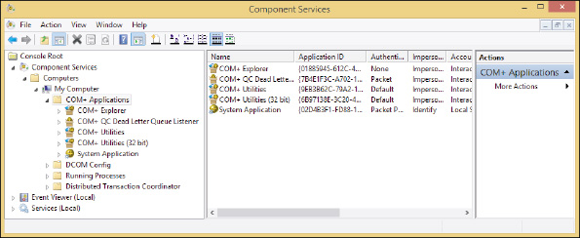
Missing DLL or Component Not Registered (2 of 2)
Figure 14-37 Use the Component Services window to register components used by an application

Slide 42
Application Has Never Worked (1 of 5)
If an application has never worked or stops working after the OS has been upgraded:
Update Windows and search the web
Run the installation program or application as an administrator
Consider whether an older application is having compatibility problems with Windows
Verify that the application is digitally signed

Slide 43
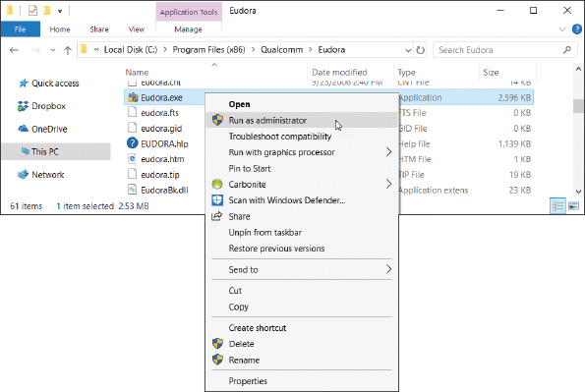
Application Has Never Worked (2 of 5)
Figure 14-38 Execute a program using administrative privileges

Slide 44
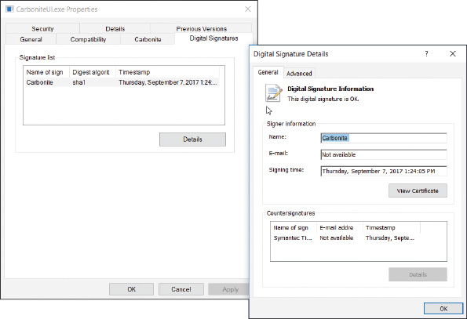
Application Has Never Worked (3 of 5)
Figure 14-40 This program is digitally signed

Slide 45
Application Has Never Worked (4 of 5)
ODBC Data Sources
Open Database Connectivity (ODBC) is the technology used to create the data source
Which provides access to a database and includes the drivers required to interface between Access and the data
Drivers for Microsoft SQL Server must be installed on the local computer
Then you can use the ODBC Data Sources tool in the Administrative tools group of Control Panel to configure the data source

Slide 46
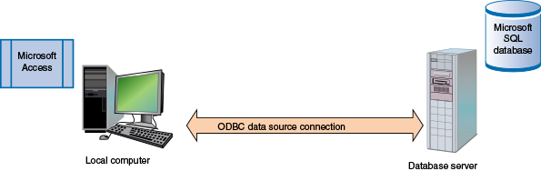
Application Has Never Worked (5 of 5)
Figure 14-41 Microsoft Access connects to an ODBC data source on a corporate network

Slide 47
An Application Fails to Uninstall
Normally, you use the Programs and Features window to uninstall an application
Some uninstall routines get corrupted and you need to manually uninstall an application
You need to know how to use the Windows Registry Editor (regedit.exe)

Slide 48
Registry Editor (1 of 5)
Changes to the registry can include adding or removing keys and their values
Or editing the values assigned to existing keys
How the Registry is Organized
The registry is a database designed with a treelike structure (called a hierarchical database)
Contains configuration information for Windows, users, software applications, and installed hardware devices
Registry is built in memory at startup
Windows uses current hardware configuration and information taken from files
Five files used to build registry are called hives:
SAM (Security Accounts Manager), SECURITY, SOFTWARE, SYSTEM, and DEFAULT hives

Slide 49
Registry Editor (2 of 5)
How the Registry is Organized (continued)
Registry is then organized into five high-level keys
Each key can have subkeys
Five keys:
HKEY_LOCAL_MACHINE (HKLM)
Contains hardware, software, and security data
HKEY_CURRENT_CONFIG (HKCC)
Used to identify each hardware device
HKEY_CLASSES_ROOT (HKCR)
Used to determine which application opens
HKEY_USERS (HKU)
Contains data about all users
HKEY_CURRENT_USER (HKCU)
Contains data about the current user

Slide 50
Registry Editor (3 of 5)
Before You Edit the Registry, Back It Up!
Ways to back up the registry:
Use System Protection to create a restore point
Back up a single registry key just before editing the key
Make an extra copy of the C:\Windows\System32\config folder
Back Up, Edit, and Restore Individual Keys
Instead of the whole registry

Slide 51
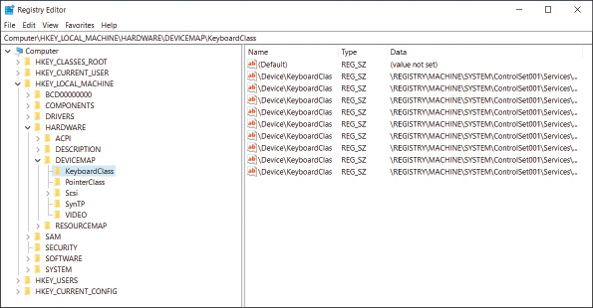
Registry Editor (4 of 5)
Figure 14-45 The Registry Editor showing the five main keys, subkeys, values, and data

Slide 52
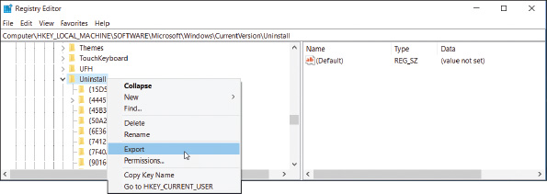
Registry Editor (5 of 5)
Figure 14-46 Using the Registry Editor, you can back up a key and its subkeys with the Export command

Slide 53
Manually Removing Software (1 of 6)
Programs refusing to uninstall or giving errors when uninstalling can be manually removed
Use as a last resort
High-level steps:
Try program’s uninstall routine
Delete the program folders and files
Delete the registry entries used by the software
Remove entries in the Start menu and delete shortcuts
Remove any entries that launch processes at startup

Slide 54
Manually Removing Software (2 of 6)
Step 1: First try the uninstall routine
Can be accessed from the Windows Programs and Features window
Or launched from the Windows 10/7 Start menu or Windows 8 Start screen
Step 2: Delete Program files
Look for the program folder in one of these folders:
C:/Program Files or C:/Program Files (x86)
Delete the RegServe folder and all its contents
If you get a message that the program is in use, you will need to stop it using Task Manager

Slide 55
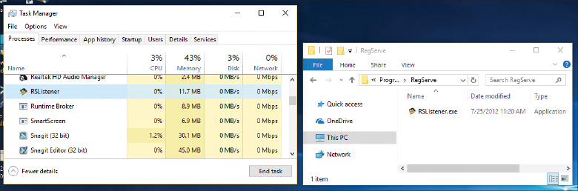
Manually Removing Software (3 of 6)
Figure 14-49 A running process prevents the RegServe folder and its running process from being deleted

Slide 56
Manually Removing Software (4 of 6)
Step 3: Delete Registry entries
Editing the registry can be dangerous – back up first!
Follow steps outlined in the text
Step 4: Remove Program Shortcuts
Step 5: Remove Startup Processes
Restart the system and watch for any startup errors about a missing program file
Use System Configuration or Task Manager to find out how the program is set to start
This entry point is called an orphaned entry
You’ll need to delete this startup entry by editing the registry, deleting a shortcut in a startup folder, or disabling a service using the Services console

Slide 57
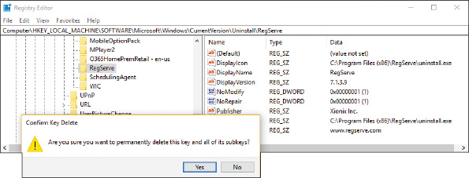
Manually Removing Software (5 of 6)
Figure 14-50 Select a subkey under the Uninstall key to display its values and data in the right pane and to delete the subkey

Slide 58
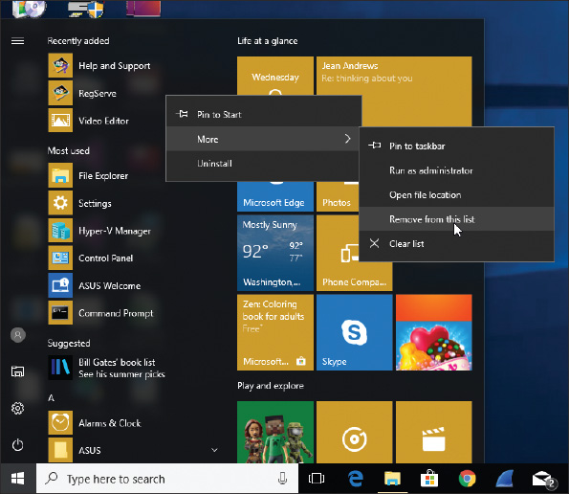
Manually Removing Software (6 of 6)
Figure 14-51 Remove an app from the Windows Start menu

Slide 59
Troubleshooting Hardware Problems in Windows
This section discusses how to deal with:
Display problems
Network printing problems
Limited network connectivity

Slide 60
Display Settings and Graphics Software (1 of 3)
Access the display settings by right-clicking the desktop and clicking Display settings
You can also click Display in the Settings window
Basic display settings:
To adjust resolution, click the Resolution drop-down menu
Select the highest or recommended resolution
Refresh rate is the number of times a monitor refreshes the screen in one second
To set the rate, click Advanced display settings, click Display adapter properties for Display and click Monitor tab and select the highest value available under Screen refresh rate
For a dual-monitor setup, you can configure multiple display
Drag the two monitor boxes so they represent the relative positions of each monitor

Slide 61
Display Settings and Graphics Software (2 of 3)
Color Depth
Accurate color representation on a monitor screen is called color depth
To get optimum color depth, you can download and apply a color profile for the monitor from the monitor manufacturer
Update DirectX
DirectX is a Microsoft software development tool that developers can use to write multimedia applications
Use the dxdiag.exe command to display information about hardware and diagnose problems with DirectX

Slide 62
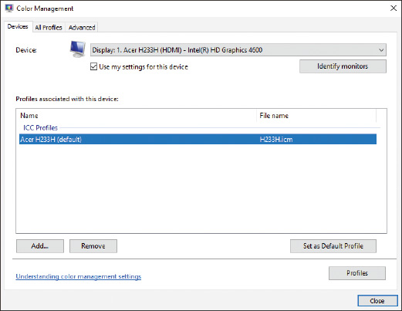
Display Settings and Graphics Software (3 of 3)
Figure 14-54 Use the Color Management box to apply a color profile

Slide 63
Print Management
Windows professional and business editions offer the Print Management (printmanagement.msc) console
In the Administrative Tools group of Control Panel
Use it to monitor and manage printer queues for all printers on the network
Each computer on the network that shares a printer to other computers on the network is considered a print server

Slide 64
Limited Connectivity (1 of 3)
List of what to try when the local network has no connectivity or limited connectivity:
1. Verify that the network cable between computer and router or wall jack is not damaged and is securely connected at both ends
2. For SOHO router, connect the cable to a different port on the router
3. Go to Device Manager on the computer and disable then enable the network adapter
Update device drivers
4. Go to the TCP/IP Properties box and verify the TCP/IP configuration for the connection
Verify the computer is getting a unique IP address from the router
5. Update the network settings and try using the following two commands:
ipconfig /release
ipconfig /renew

Slide 65
Limited Connectivity (2 of 3)
List of what to try when the local network has no connectivity or limited connectivity (continued):
6. Try resetting the modem and router
7. The computer might have malware, try running anti-malware software
8. For wireless connections, check these things:
For a laptop, is the wireless switch turned on?
Disconnect and reconnect to the wireless network
For Mac address filtering, is the computer’s MAC address allowed on the network?
Is the wireless device too far from the wireless access point so that the signal is too weak?

Slide 66
Limited Connectivity (3 of 3)
List of what to try when the local network has no connectivity or limited connectivity (continued):
9. For Internet connectivity, do the following:
To eliminate DNS as the problem, try this command:
ping www.cengage.com
If you are unable to access a particular computer on the Internet, try using the tracert command:
tracert www.cengage.com
If you can access resources on the local network but don’t have Internet connectivity, contact your ISP and ask them to reset the connection at their end

Slide 67
Chapter Summary (1 of 3)
The Windows OS is made up of two main components: the shell and the kernel
A process is a program running under the shell, together with all the resources assigned to it
Windows tools that access and manage other Windows tools are Control Panel, Administrative Tools, Computer Management, and Microsoft Management Control (MMC)
Tools to observe, track, and log Windows, user, network, application, and hardware activities are Event Viewer, Performance Monitor, Reliability Monitor, and Resource Monitor
Tools for solving Windows, application, networking, and Windows user problems are Task Manager, System Configuration, the Services console, the Troubleshooting applet, Group Policy, Local Group Policy, and the Registry Editor
Other tools are System File Checker, DISM, Windows Updates, a clean boot, Safe Mode (Safe boot), and System Restore

Slide 68
Chapter Summary (2 of 3)
Tools for solving application errors and crashes are Programs and Features, tasklist, taskkill, Component Services, secondary logons, Compatibility mode, digital signatures, Data Sources, and Task Scheduler
Tools for solving problems with hardware are Device Manager, Print Management, the Display applet, DxDiag, Memory Diagnostics, chkdsk, and Disk Defragmenter
The commands taskkill and tasklist can be used to forcefully end an application that is hung
Task Manager can change the priority level to improve performance of an application
The Services console is used to change the way a background service is started
Use Component Services to solve the problem that causes an error message to appear for an unregistered component or missing DLL
When an application fails to uninstall, you might need to manually edit Windows registry using the Registry Editor

Slide 69
Chapter Summary (3 of 3)
Always back up registry keys before editing them
Use Display settings to adjust the resolution, refresh rate, multiple monitor orientation, and color depth for monitors
Use the dxdiag command to determine which version of DirectX is installed
Print Management makes it easy to manage network printers and their connections with workstations on the network
Limited network connectivity problems can be solved by verifying network cable connections, network port activity, NIC device drivers, TCP/IP configuration (network settings), cable or DSL modem connectivity to the ISP, wireless connectivity and access, and DNS name resolution

